Slide 1
Blockchain
Consensus Protocols

Slide 2
agree on some value,
leader election,
agree on transactions order …
Consensus algorithm
peer-to-peer network

Slide 3
distributed transaction ledger
Consensus algorithm
peer-to-peer network

Slide 4
Consensus protocols: Technology that enables decentralization. Ensures all participants agree on a unified transaction ledger without a central authority.
distributed transaction ledger
Consensus algorithm: PoW, PoS, DPoS, PoET, PoA ...
peer-to-peer network

Slide 5
Consensus protocols: Technology that enables decentralization. Ensures all participants agree on a unified transaction ledger without a central authority.
distributed transaction ledger
incentive
mechanism (only in blockchain consensus, prevent sybil attacks)
message passing/information propagation
Consensus algorithm: PoW, PoS, DPoS, PoET, PoA ...
block proposing schemes
nodes decisions
block finalization
peer-to-peer network
block validation

Slide 6
Bitcoin protocol
Block generation: PoW find nonce, hash satisfies a difficulty target
Block propagation: gossiping any block (received or locally generated) should be advertised to peers and broadcast
Block validation: check block header and transactions
Longest-chain rule: Blocks should always extend the longest chain.
Rewards: coinbaise transactions.

Slide 7

distributed transaction ledger
Consensus algorithm
process failures:
Power shutdown,
Software errors,
DoS attacks
Byzantine failures
Systems seems to
work normally
Adversarial nodes
send contradicting/false
messages
peer-to-peer network
Fault tolerant: ability of a distributed network to reach consensus
despite system failures/malicious nodes sending incorrect messages.

Slide 8
Consensus protocols
On blockchain: ensures all participants agree on a unified transaction ledger without the help of a central authority.
All agents (nodes) in a distributed system agree on the same value.
Agents agree on a majority value.
Process failure
power shutdown, software errors, attacks (DoS) etc.
Byzantine failure
Node sending faulty messages, acts as a non-faulty node.

Slide 9
Consensus protocols requirements

Slide 10
PoW
energy consumption.
small number of transactions/sec 7TPS.
decreasing incentives.
Fault tolerant?
Performance?
Scalability?
Transaction capability?
Security?

Slide 11
Fault tolerant protocols requirements
Agreement (Safety): “a bad thing never happens ”
Correct nodes agree on the same value.
➔
Node 1:
vote 1
Node 1:
final vote 0
Node 2:
final vote 0
Node 5:
vote 1
Node 2:
final vote 0
Node 5:
final vote 0
Node 3:
final vote 0
Node 4,
final vote 0
Node 3:
final vote 0
Node 4,
final vote 0

Slide 12

Fault tolerant protocols requirements
Termination (Liveness): a good thing will eventually happen ”
All nodes will eventually make a decision, in a finite amount of time.
Node 1:
???
Node 1:
final vote 0
Node 2:
final vote 0
Node 5:
???
Node 2:
final vote 0
Node 5:
final vote 0
Node 3:
final vote 0
Node 4,
final vote 0
Node 3:
final vote 0
Node 4,
final vote 0

Slide 13
Safety = all nodes agree on transactions
Blockchain,
agree on a majority value
= longest chain
Liveness = a new block will be added

Slide 14
Fault tolerant protocols requirements
Validity:
If every correct (non faulty) process begins with the same
initial value v , then their final decision must be v.
Integrity:
The consensus value v must have been proposed by some nonfaulty process.

Slide 15
Blockchain consensus
Termination: Honest nodes either discard or accept a transaction, within the content of a block.
Agreement: An accepted transaction is accepted by all honest nodes. A block has the same sequence number at every honest node (same order).
Validity: If a node receives a valid transaction/ block, it should accept it into the blockchain.
Integrity: check hash, signatures, chronological order, no double spending.

Slide 16
Consensus protocols
Synchronous systems processes operate in rounds of time.
Round → process receive messages sent to it in the previous round
→ process message and send messages
Centralized clock synchronization
Fixed message delivery delay.
Asynchronous systems no time order on communications.
no centralized clock
Partial synchronous systems
communications arrive within a certain (not known) time frame.

Slide 17
Synchronous systems
time T fixed & known
Asynchronous systems
time not fixed
(no upper bound exists)
Partial Synchronous systems
time T fixed &
not known

Slide 18
Consensus protocols
FLP (Fischer, Lynch, Paterson) theorem [1]
In asynchronous systems consensus cannot be guaranteed,
even with a single crash failure.
safety and liveness cannot be simultaneously guaranteed.
Atomic broadcast and consensus are equivalent problems. [2]
All servers start with the same state, receive the same sequence of requests and output the same execution results, ending in same state.

Slide 19
Practical Byzantine Fault Tolerance (PBFT)
Consensus protocol for partially synchronous networks

Slide 20
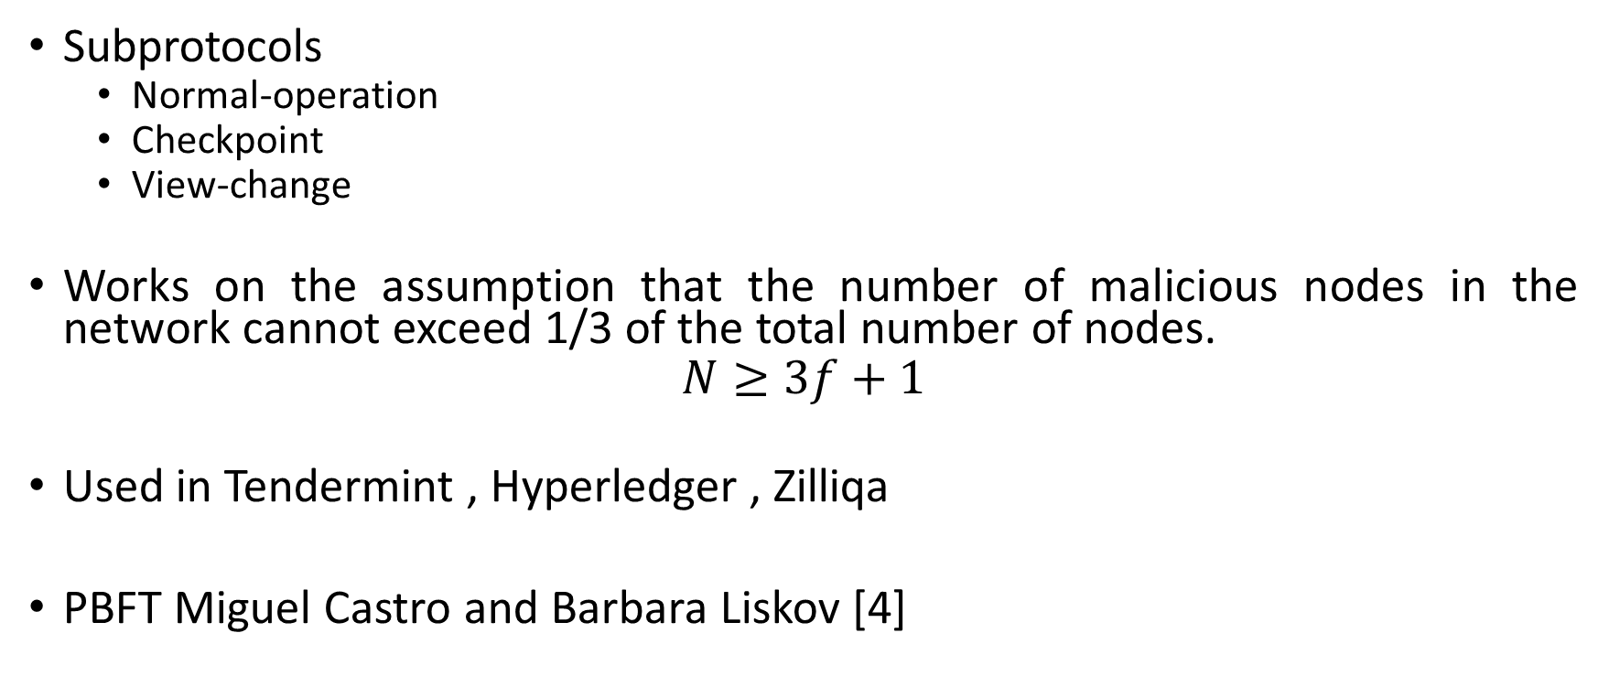
Practical Byzantine Fault Tolerance (PBFT)
Subprotocols
Normal-operation
Checkpoint
View-change
Works on the assumption that the number of malicious nodes in the network cannot exceed 1/3 of the total number of nodes.
$$N≥3f+1$$
Used in Tendermint , Hyperledger , Zilliqa
PBFT Miguel Castro and Barbara Liskov [4]

Slide 21
PBFT
Normal operation round (view) phases:
request: Client sends the request to the primary replica;
pre-prepare: Primary replica sends the requests to the backup replicas at the same time;
prepare: Replicas send responses to all servers (replicas and primary).
commit: After receiving ≥ 2f +1 prepare messages, a server sends commit messages to all servers;
response: After receiving ≥ 2f +1 commit messages, a server sends response to client;

Slide 22
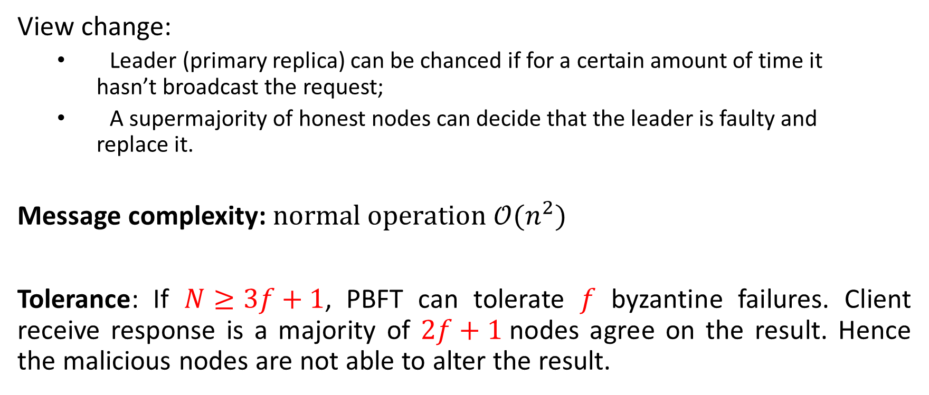
PBFT
View change:
Leader (primary replica) can be chanced if for a certain amount of time it hasn’t broadcast the request;
A supermajority of honest nodes can decide that the leader is faulty and replace it.
Message complexity: $normal operation 𝒪(n^{2})$
Tolerance: If $N≥3f+1$, PBFT can tolerate $f$ byzantine failures. Client receive response is a majority of $2f+1$nodes agree on the result. Hence the malicious nodes are not able to alter the result.

Slide 23
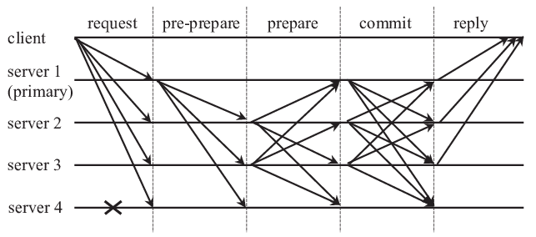
PBFT normal operation
image source [4]

Slide 24
Tendermint
A node, the client, sends a proposed block to another node, the primary.
Primary multicast the proposed block to backups.
The primary sends pre-prepare messages to backups. Pre-prepared messages are accepted, and node enters prepare phase.
Backup sends prepare message to other nodes. If prepare message is verified it enters commit phase
If the commit message is accepted the block is registered in the blockchain.

Slide 25
Tendermint
Blockchain protocol used to replicate blockchain applications.
If consists of:
A blockchain consensus engine (Tendermint Core)
A generic application interface (ABCI) process transactions in any programming language.
Cosmos network: decentralized system of connected independent blockchains.
IoB internet of Blockchains
ATOM cryptocurrency running on Cosmos network.

Slide 26
Tendermint
Valiator
node that validates transactions on the network.
commits new blocks in the blockchain.
validators vote on proposals.
receive incentives.
weight of validator is determined by the amount of staking tokens.
Tokens can be self-delegated or delegated to some delegators.
Requirements: uptime, availability, minimum ATOM balance.

Slide 27
Tendermint
Delegator
ATOM holders can delegate ATOM to a validator and obtain a part of their revenue in exchange. .
If a validator misbehaves, each of their delegators are partially slashed in proportion to their delegated stake.
Validators can be in jailed state.

Slide 28
PoS protocols

Slide 29
Consensus protocols
PoW
PoS
computation power
miner
block reward
probabilistic block finalization
stake value
validator/stakeholder/minter
user can lose a portion of their stake/transaction fees
staking pools
deterministic block finalization

Slide 30
PoS consesnsus
PoS Energy efficient: Instead of doing hard computational work, miners stake coin in the network to be allowed to generate new blocks. (stake 32 ETH for Ethereum); reduce hardware requirements.
Stake: coins invested in consensus process.
Coin age: currency_amount * holding_period.
Immunity to centralization: more nodes in the network.
Validators replace miners.
Validators are chosen at random to create new blocks.
Validators check and confirm blocks they don’t create.

Slide 31
PoS consesnsus
A validator can lose a portion of their stake or lose the entire stake. 51% attack cause coin value to drop.
Validators get rewards for proposing new blocks and for validating blocks proposed by other validators.
Validators check and confirm blocks they don’t create.
In some PoS protocols validator’s chances to be selected as proposing validator are proportional to stake.
In Ethereum validators are randomly selected by Beacon chain.
Beacon chain manages validators (stake deposits, regards and penalties)

Slide 32
PoS consesnsus
Support for shard chains: scalability, increase transactions per second, needs deterministic finality.
Beacon chain (PoS consensus – needs finality)
receives information from shards and sync the network.
manage validators
records block attestations
Phase 0 – 1 Dec 2020

Slide 33
PoS consesnsus
Support for shard chains: scalability, increase transactions per second, needs deterministic finality.
Shard chains (2023)
receive transaction
follow the merge of mainnet with Beacon chain
improve scalability and capacity
layer 2 solution

Slide 34
PoS consesnsus
Ethereum 2.0:
Validators (committee) are required to attest shar blocks.
A committee has a slot (time-frame) to propose and validate a shard block. There are 32 slots in an epoch.
After each epoch, the committee is reformed with different random validators.
When a new shard block proposal has enough attestations, a crosslink is created on beacon chain.
Following the creation of crosslink, the validator who proposed the block receives the reward.
If 2/3 of validators agree, the block is finalized.

Slide 35
chain-based PoS
similar to Bitcoin (block validation, block finalization - longest chain rule )
Peercoin,
PoAct (Decred (DCR))
committee-based PoS
MPC multiparty computation
CoAct
BFT-based PoS
Staking and PBFT consensus
Tendermint,
Casper FFG
Delegated PoS
A group of delegates validates transactions
Lisk,
Cosmos

Slide 36
BFT – PoS protocols
Deterministic block finalization
Longest chain rule replaced by: most-recent-stable-checkpoint rule.
Tendermint [3], first public blockchain with BFT-PoS consensus protocol.
Partial Synchronous system.

Slide 37
Casper FFG
Casper the Friendly Finality Gadget

Slide 38
Casper FFG
Combines chain PoS and PFT consensus.
Provides any PoW chain with additional protection against block reversion.
Overlay atop proposal mechanism a protocol to finalize blocks, selecting the canonical chain.
Modular: may be implemented as an upgrade to an existing PoW chain.
BFT algorithms: mathematically proven properties: if 2/3 of protocol participant are following the protocol rules, algorithm ensures validity.
Safety: Casper protects against finalizing two conflicting checkpoints.
Liveness: depends on a chosen proposal mechanism, could not ensure finalizing any future checkpoints.

Slide 39
Casper FFG
Fix set of validators and propose mechanism (PoW, PoS).
Accountability: penalize validators (nothing at stake problem)
Dynamic set of validators
2/3 of validators refers to 2/3 of the deposit-weighted fraction.
Block tree: root is the “genesis block”.
Casper choose a single child from each parent (canonical chain), some blocks are forming the checkpoint tree.
Checkpoint: genesis block and every block whose height in the block tree is an exact multiple of 100.

Slide 40
b2
h(root) = 0
h(b1) = 1
h(b2) = 3
root, b1, b2 checkpoints
100 blocks
b1
Genesis

Slide 41
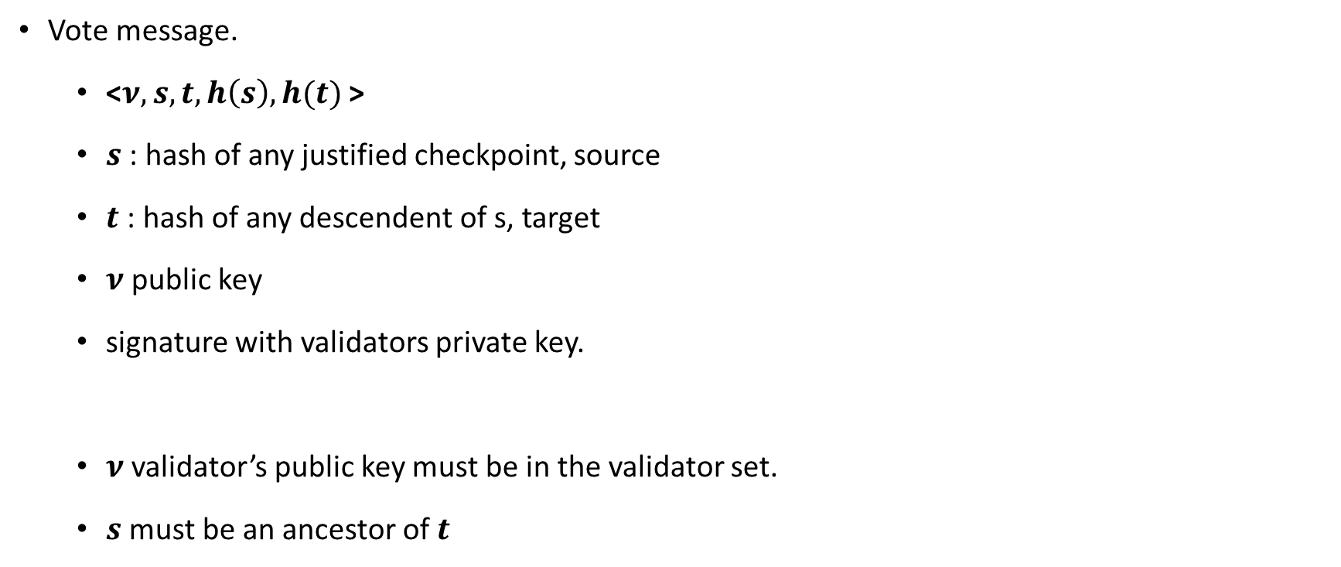
Casper FFG
b3
Vote message.
<$ν,s,t, h\left(s\right),h(t)$ >
$s$: hash of any justified checkpoint, source
$t$: hash of any descendent of s, target
$ν$public key
signature with validators private key.
$ν$validator’s public key must be in the validator set.
$s$ must be an ancestor of $t$
b2
100 blocks
b1
Genesis

Slide 42

Casper FFG
b3
Vote message.
<$ν,s,t, h\left(s\right),h(t)$ >
<$ν,hash\left(b1\right),,hash\left(b3\right), 1,4$ >
$s$: hash of any justified checkpoint, source
$t$: hash of any descendent of s, target
$ν$public key
signature with validators private key.
b4 and b3 conflicting
b4
b2
100 blocks
b1
Genesis

Slide 43

Casper FFG
b3
Supermajority link
$a→b$order pair of checkpoints such that
at least 2/3 of validators have published votes
<$ν,a,b,h(a), h(b)$>
b2
100 blocks
b1
Genesis

Slide 44

Casper FFG
b3
$c$Justified checkpoint:
root is justified.
There exists a supermajority link $c′→c$
where $c′$ is justified.
b2
b1
Genesis

Slide 45
Casper FFG
b3
$c$Justified checkpoint:
root is justified.
There exists a supermajority link $c′→c$
where $c′$ is justified.
b2
b1
Genesis

Slide 46
Casper FFG
b3
$c$Justified checkpoint:
root is justified.
There exists a supermajority link $c′→c$
where $c′$ is justified.
b2
b1
Genesis

Slide 47
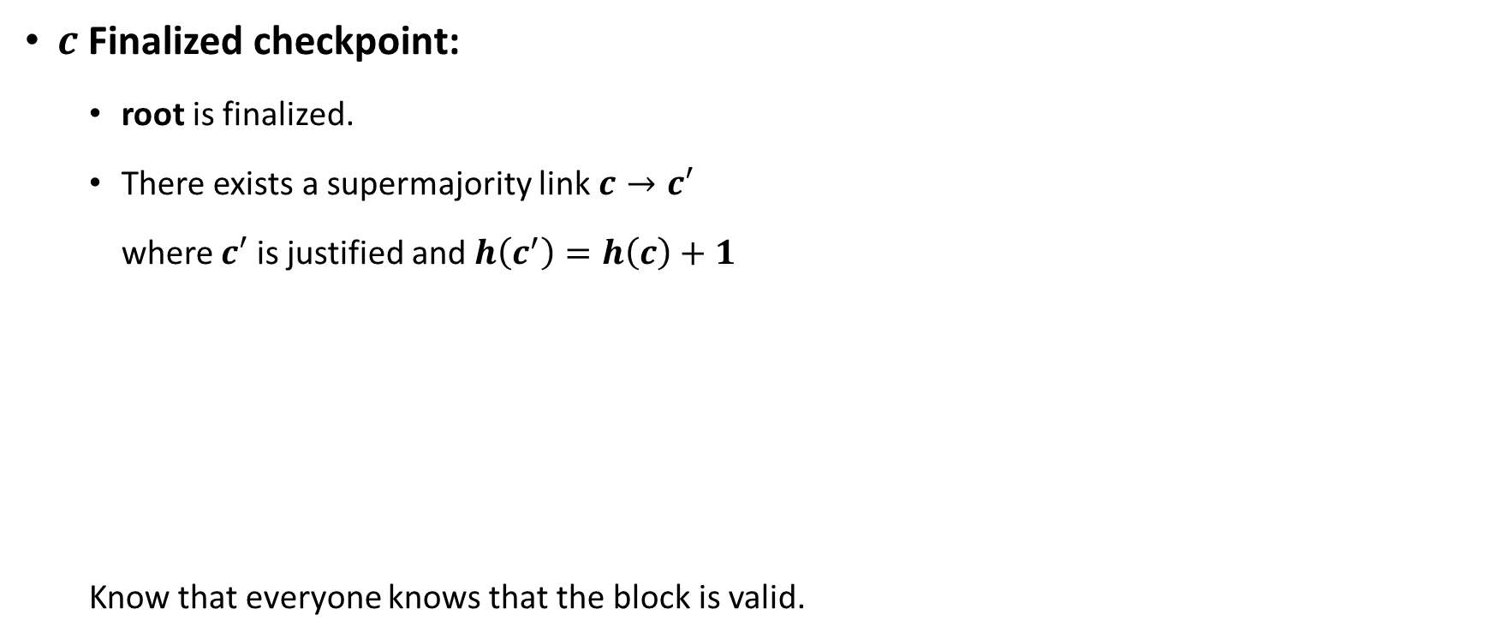
Casper FFG
b3
$c$Finalized checkpoint:
root is finalized.
There exists a supermajority link $c→c′$
where $c′$ is justified and $h\left(c^{′}\right)=h\left(c\right)+1$
Know that everyone knows that the block is valid.
b2
b1
Genesis

Slide 48

Casper FFG
b4
b3
Slashing condition I:
No double votes.
A validator cannot vote:
<$ν,s1,t1, h\left(s1\right),h(t1)$ >
<$ν,s2,t2, h\left(s2\right),h(t2)$ >
Such that $h\left(t1\right)=h(t2)$
b2
b1
Genesis

Slide 49
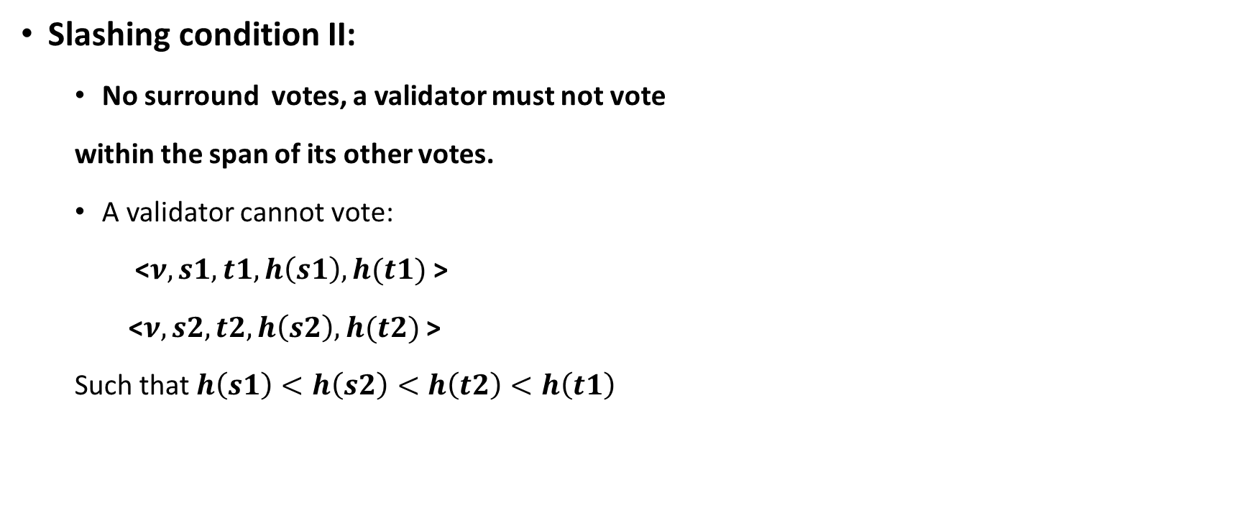
Casper FFG
b3
Slashing condition II:
No surround votes, a validator must not vote
within the span of its other votes.
A validator cannot vote:
<$ν,s1,t1, h\left(s1\right),h(t1)$ >
<$ν,s2,t2, h\left(s2\right),h(t2)$ >
Such that $h\left(s1\right)<h\left(s2\right)<h\left(t2\right)<h\left(t1\right)$
b2
b1
Genesis

Slide 50
Casper FFG
If a validator violets a slashing condition the evidence is include in the blockchain as a transaction, stake is slashed, and finder gets a fee.
It is impossible for any two conflicting checkpoints to be finalized unless >= 1/3 of the validators violates one of the slashing conditions.
Accountable safety: Two conflicting checkpoints cannot both be finalized unless at least one third of the total deposit is lost.
Plausible liveness: It’s always possible to finalize a new checkpoint without violation of slashing conditions, provided there exist children extending the finalized chain.
Fork choice rule: Follow the chain containing the justified checkpoint of the greatest height.

Slide 51

Casper FFG
b4
b3
Accountable safety proof:
Two conflicting checkpoints $a_{m}$and $b_{m}$:
$a_{m} →a_{m+1}{ b}_{m} →b_{m+1}$
${h(a}_{m})<h\left(b_{m}\right)$ (slashing condition I)
a3
a2
b2
a1=b1

Slide 52
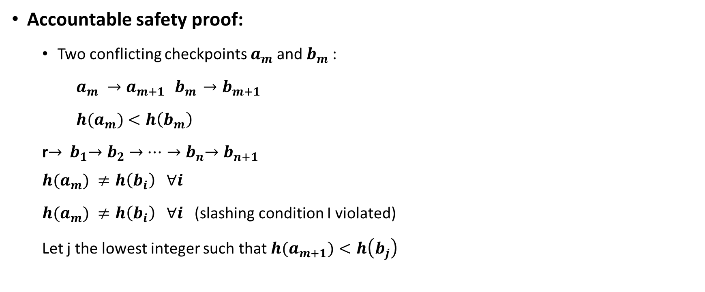
Casper FFG
b4
b3
Accountable safety proof:
Two conflicting checkpoints $a_{m}$and $b_{m}$:
$a_{m} →a_{m+1}{ b}_{m} →b_{m+1}$
${h(a}_{m})<h\left(b_{m}\right)$
r$→{ b}_{1}{→b}_{2} →…{→b}_{n}{→b}_{n+1}$
$${h(a}_{m}) ≠h\left(b_{i}\right) ∀i$$
${h(a}_{m}) ≠h\left(b_{i}\right) ∀i$ (slashing condition I violated)
Let j the lowest integer such that ${h(a}_{m+1})<h\left(b_{j}\right)$
a3
a2
b2
a1=b1

Slide 53
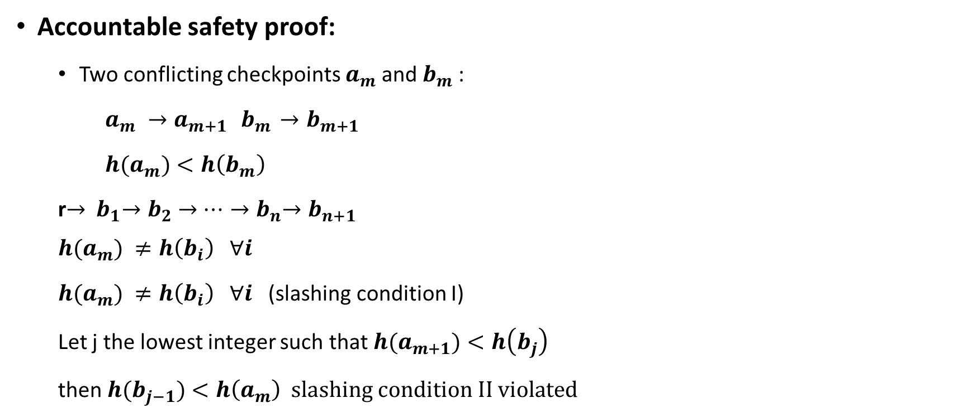
Casper FFG
b4
b3
Accountable safety proof:
Two conflicting checkpoints $a_{m}$and $b_{m}$:
$a_{m} →a_{m+1}{ b}_{m} →b_{m+1}$
${h(a}_{m})<h\left(b_{m}\right)$
r$→{ b}_{1}{→b}_{2} →…{→b}_{n}{→b}_{n+1}$
$${h(a}_{m}) ≠h\left(b_{i}\right) ∀i$$
${h(a}_{m}) ≠h\left(b_{i}\right) ∀i$ (slashing condition I)
Let j the lowest integer such that ${h(a}_{m+1})<h\left(b_{j}\right)$
then ${h(b}_{j−1})<h\left(a_{m}\right) slashing condition II violated$
a3
a2
b2
a1=b1

Slide 54
Chain based PoS protocols

Slide 55
Chain based PoS protocols
Similar to PoW, features a chain of blocks.
Block generation Hash ( header | clock_time ) < target * stake

Slide 56
Peercoin
Peercoin whitepaper [1]: “If Bob has a wallet-output which accumulated 100 coin-age and expects it to generate a kernel in 2 days, then Alice can roughly expect her 200 coin-age wallet-output to generate a kernel in 1 day”.
Kernel: coinstake transaction input.
Only coins kept in wallet for 30 days can be used for the creation of a new block.
Coin valuation increases linearly with time since deposited in wallet, starting with day 30 to day 90.
At the end of the block generation stake value returns to its initial value.
Main chain: the chain with the bigger total amount of spent coin age.

Slide 57
Proof of activity
Proof of Activity paper (Bentov) [2]: “. if Alice has 2 coins and Bob has 6 coins then Alice is 3 times less likely to be picked (as validator) compared to Bob.”
Hybrid PoW/PoS. [2]
Probabilistic finality.
FTS algorithm (follow the satoshi) [2]:
“transform some pseudorandom value into a satoshi (smallest unit of the cryptocurrency) that is picked uniformly among all the satoshis that have been minted thus far.”
“inspect the block in which this satoshi was minted, and following each transaction that transferred this satoshi to a subsequent address until reaching the address that currently controls this satoshi.”
CoA: adapted version, a committee is elected with FTS to generate blocks. MPC (multipart computation scheme ensures that all members of the committee output the same result)

Slide 58
Proof of activity
[2] GENERATE BLOCK HEADER Each miner uses his hashpower to try to generate an empty block header, i.e. header data that consists of the hash of the previous block, the miner’s public address, height relative to the genesis block (a.k.a. the index of the block in the blockchain), and a nonce. This header does not reference any transactions.
BROADCAST HEADER When a miner succeeds in generating an empty block header, meaning that the hash of her block header data is smaller than the current difficulty target, she broadcasts her block header to the network.
HASH (header | parent_header | N suffix values) ➔ FTS All the network nodes regard the hash of this block header as data that deterministically derives N pseudorandom stakeholders. The derivation is done by concatenating this hash with the hash of the previous block and with N fixed suffix values, then hashing each combination, and then invoking follow the-satoshi with each of the N hashes as input.

Slide 59
Proof of activity
[2] N BLOCK VALIDATORS
Every stakeholder checks whether the empty block header that the miner broadcasted is valid (hash of the previous block, current difficulty);
sign the hash of this empty block header with the private key that controls their derived satoshi
Nth stakeholder creates a wrapped block that extends the empty block header by including as many transactions as she wishes to include, the N − 1 signatures of the other derived stakeholders, and his own signature for the hash of this entire block.
LONGEST CHAIN The Nth stakeholder broadcasts the wrapped block to the network. The nodes try to extend the longest branch of the blockchain that they are aware of.
REWARDS The fees from the transactions that the Nth stakeholder collected are shared between the miner and the N lucky stakeholders

Slide 60
Bibliography
[1] Fischer, Michael J., Nancy A. Lynch, and Michael S. Paterson. "Impossibility of distributed consensus with one faulty process." Journal of the ACM (JACM) 32.2 (1985)
[2] X. Defago, A. Schiper, and P. Urban, “Total order broadcast and ´ multicast algorithms: Taxonomy and survey,” ACM Computing Surveys, 2004.
[3] M. Castro, B. Liskov et al., “Practical byzantine fault tolerance,” in
OSDI, vol. 99, 1999, pp. 173–186
[4] Lei, Kai & Zhang, Qichao & Xu, Limei & Qi, Zhuyun. (2018). Reputation-Based Byzantine Fault-Tolerance for Consortium Blockchain. 10.1109/PADSW.2018.8644933.
[5] Casper FFG
https://arxiv.org/pdf/1710.09437&ved=2ahUKEwj35u-T2LDuAhVEwVkKHWBhBAAQFjABegQIChAC&usg=AOvVaw1vgEz3zlMlgO9ffpXDKuRt

Slide 61
Bibliography
[6] https://www.peercoin.net/whitepapers/peercoin-paper.pdf
[7] https://eprint.iacr.org/2014/452.pdf
[8] https://tendermint.com/static/docs/tendermint.pdf
[8] https://ethereum.org/en/developers/docs/consensus-mechanisms/
[10]https://support.blockchain.com/hc/en-us/articles/360000939883-Explaining-bitcoin-transaction-fees
[11] https://en.bitcoin.it/wiki/Controlled_supply
[12] https://eips.ethereum.org/EIPS/eip-3143

